Slide 1
Lesson 12: Transfer Functions In The Laplace Domain
ET 438a Automatic Control Systems Technology

Slide 2
Learning Objectives
After this presentation you will be able to:
Define the terms pole, zero and eigenvalue as they pertain to transfer functions.
Identify the location of poles and zeros on the complex plane.
Develop transfer functions from OP AMP circuits using the Laplace variable.
Develop transfer functions of electromechanical systems using the Laplace variable.
Find the values of poles and zeros given a transfer function.

Slide 3
Definition of Transfer Function
Input/output relationships for a mathematical model usually given by the ratio of two polynomials of the variable s.
R(s)
G(s)
C(s)
Where
All a’s and b’s are constants
Order of numerator is less that the denominator

Slide 4
Definition of Transfer Function
Example
Output
X(s)
G(s)
Y(s)
Input
Y(s)= G(s)∙X(s)
Transfer function is the “gain” of the block as a function of the Laplace
variable s.

Slide 5
Transfer Function Terminology
Definitions:
Poles - roots of the denominator polynomial. Values that caus transfer function magnitude to go to infinity.
Zeros - roots of the numerator polynomial. Values that cause the transfer function to go to 0.
Eigenvalues - Characteristic responses of a system. Roots of the denominator polynomial. All eigenvalues must be negative for a system transient (natural response) to decay out.
Zeros
Poles

Slide 6
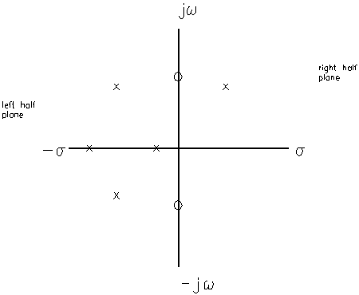
Pole/Zero Plots
Transfer function poles and zeros determine systems’ responses. Plotted on the complex plane (s,jω).
X’s indicate pole location
Closer pole is to imaginary axis slower response.
Complex roots appear in conjugate pairs
Circle is location of zero

Slide 7
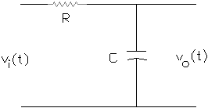
Transfer Function Examples
Example 12-1: Find the transfer function of the low pass filter shown below. Draw a block diagram of the result showing the input/output relationship.
Write a KVL equation around the RC loop.
i(t)
Take Laplace Transform of the above equation
Now find the current from the above equation

Slide 8
Transfer Function Example 12-1 (1)
Solve for I(s)
Factor out I(s)
Divide both sides by (R+1/Cs)
Remember
Substitute I(s) into
above equation and simplify

Slide 9
Transfer Function Example 12-1 (2)
Final formula
Draw block diagram
V_{i}(s)
V_{o}(s)
RC is time constant of system.
System has 1 pole at -1/RC and no zeros.
Larger RC gives slower response.

Slide 10
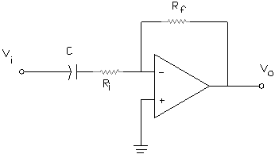
Transfer Functions of OP AMP Circuits
Example 12-2: Find the transfer function of a practical differentiator- active high pass filter with definite low frequency cutoff.
Z_{f}(s)
Solution Method: Take Laplace transform of components and treat them like impedances.
For capacitor
Z_{i}(s)
General gain formula
Define
Z’s

Slide 11
Transfer Functions of OP AMP Circuits
Example 12-2 Solution (2)
Substitute into gain formula
Simplify ratio
Transfer Function
Transfer function has 1 zero at s=0 (R_{f}Cs=0) and 1 pole at s=-1/R_{i}C (R_{i}Cs+1=0)

Slide 12
Transfer Functions of OP AMP Circuits
Block diagram equivalent of OP AMP circuit
V_{i}(s)
V_{o}(s)
Now consider cascaded OP AMP circuits. Similar to the constants used previously. For series connected circuits, multiply the gains (transfer functions) .
Note: do not cancel common terms from numerator and denominator.

Slide 13
Cascaded OP AMP Circuits
R(s)
G₁(s)
X₁(s)
G₂(s)
X (s)
Stage 1
R(s)∙G₁(s)=X₁(s) Equation (1)
Stage 2
X₁(s)∙G₂(s)=X (s) Equation (2)
Substitute (1) into (2) and simplify to get overall gain
X₁(s)=R(s) ∙G₁(s)
R(s) ∙G₁(s) ∙ G₂(s)=X (s)
X(s)/R(s)= G₁(s) ∙ G₂(s)

Slide 14
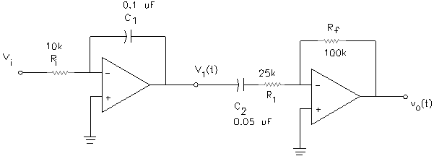
OP AMP Example
Example 12-3: Find the transfer function of the cascaded OP AMP circuit shown. Determine the number and values of the poles and zeros of the transfer function if they exist.
Stage 1
Integrator
Circuit
Stage 2: Practical Differentiator
Circuit

Slide 15
Example 12-3 Solution
Solution Method
Take Laplace transform
of components and use general gain formula
Stage 1
Stage 2

Slide 16
Example 12-3 Solution (2)
G₂(s) was derived previously (practical differentiator)
Negative signs cancel

Slide 17
Example 12-3 Solution (3)
Overall transfer function
Simplified form
Plug in given values for the component symbols and compute parameters
R_{f}∙C₂ = 100 kΩ ∙0.05 μf
R_{f}∙C₂ =0.005
R₁∙C₂ = 25 kΩ ∙0.05 μf
R₁∙C₂ =0.001
R_{i}∙C₁ = 10 kΩ ∙0.1 μf
R_{i}∙C₁ =0.001

Slide 18
Example 12-3 Solution (4)
Final transfer function- all values included
Function has 1 zero and 2 poles
Zero at s=0
0.005s=0
Pole at s=-1/0.001=-1000
0.001s+1=0
Pole at s=0
0.001s=0
V_{i}(s)
V_{o}(s)

Slide 19
Parallel Blocks
Overall transfer function is the algebraic sum of the signs entering summing point
G₁(s)
+
Y(s)
R(s)
G₂(s)
+

Slide 20
Parallel Blocks
G₁(s)
Subtraction in
Summing block
-
Y(s)
R(s)
G₂(s)
+

Slide 21
Laplace Block Simplifications
Feedback systems with unity gain feedback
R(s)
+
E(s)
G (s)
C(s)
Equivalent Equation
-
Equivalent block
R(s)
C(s)

Slide 22
Laplace Block Simplifications
Feedback systems with non-unity gain feedback
R(s)
+
E(s)
G (s)
C(s)
Equivalent Equation
-
H (s)
G(s)= forward path gain
H(s) = feedback path gain
Equivalent block
R(s)
C(s)

Slide 23
End Lesson 12: Transfer Functions In The Laplace Domain
ET 438a Automatic Control Systems Technology

